Slide 1
Welcome to Musicville
The place where Learning is always fun!!!!

Slide 2
What have we learned so far?
Singing
Playing
Reading
Improvising
Composing
Listening Analyzing & Describing
Evaluating
Relationships between other subjects
Understanding Music with history
Moving

Slide 3
Listening Analyzing & Describing
GPS 6
Instrument Family Recognition

Slide 4
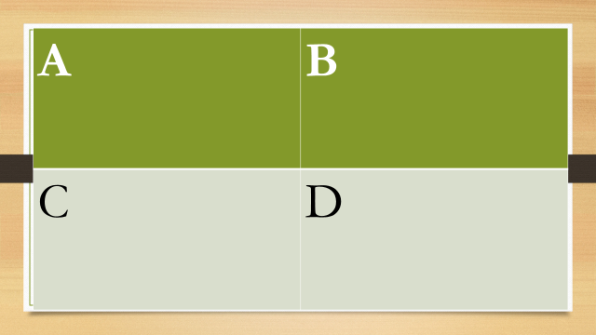




https://www.youtube.com/watch?v=i2uYb6bMKyI

Slide 5

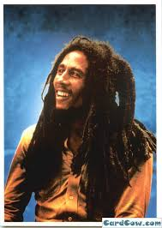
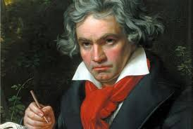
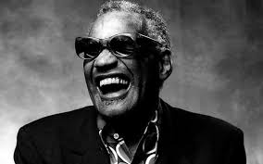
https://www.youtube.com/watch?v=OD3F7J2PeYU

Slide 6
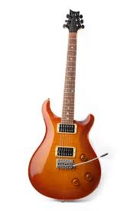
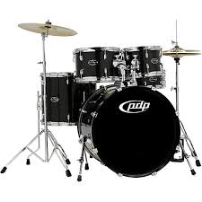
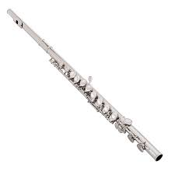
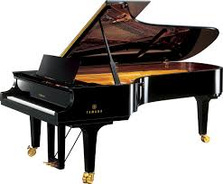
https://www.youtube.com/watch?v=nIlhL4PbVno

Slide 7

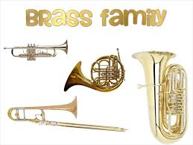
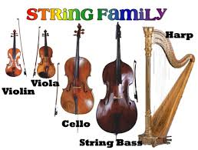
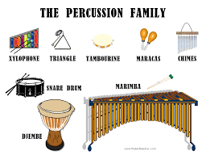
https://www.youtube.com/watch?v=oUArZTrU3Ew

Slide 8
Reading & Notating Music
GPS 3

Slide 9


Slide 10
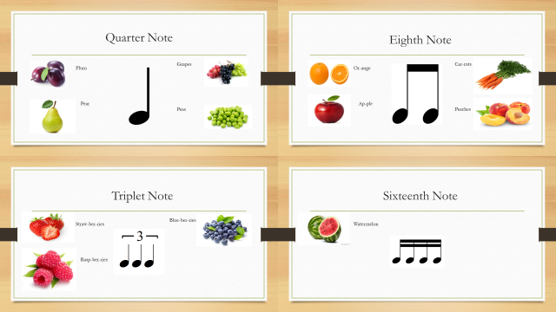
https://www.youtube.com/watch?v=Dst0AdVB21Q

Slide 11
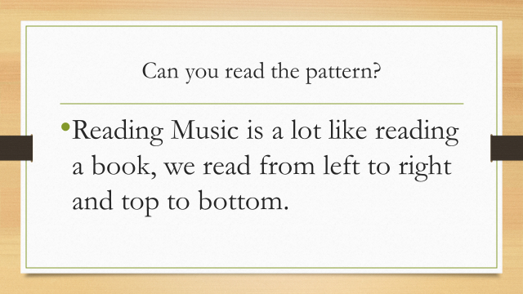

Slide 12
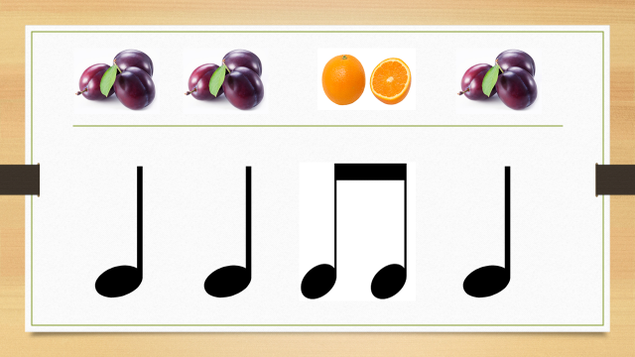

Slide 13
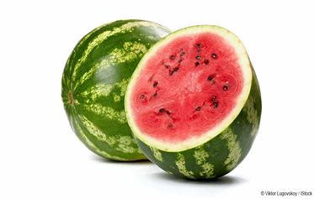

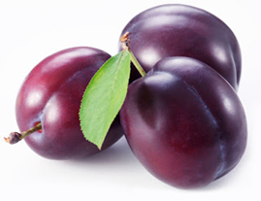
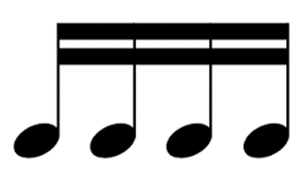



Slide 14

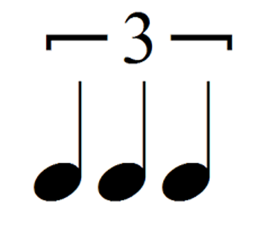

Slide 15
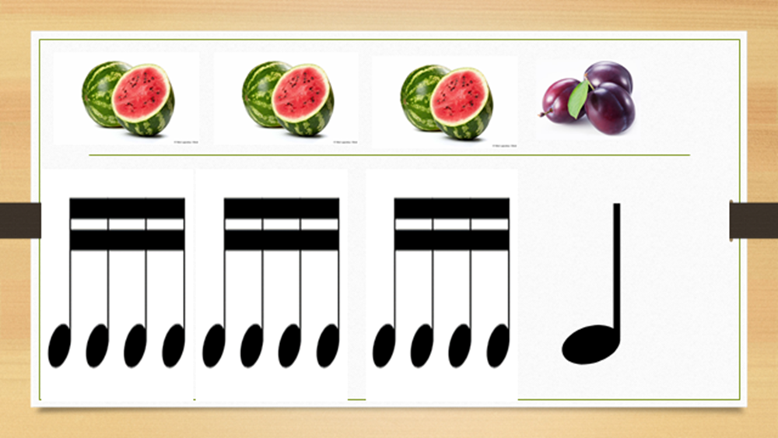
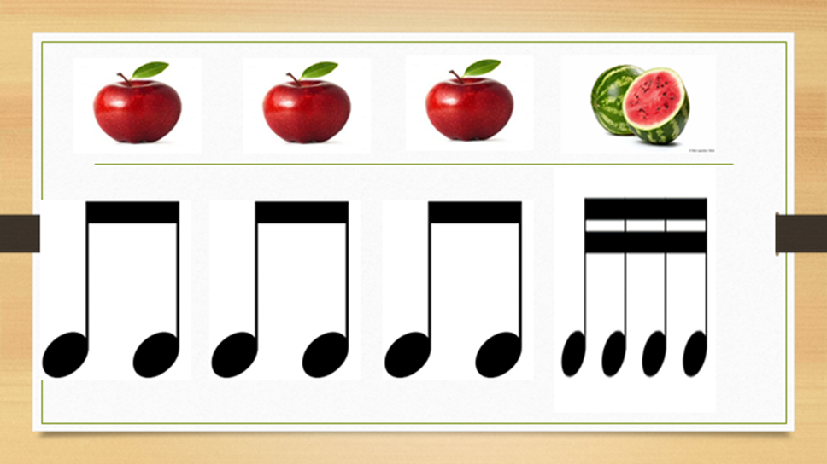
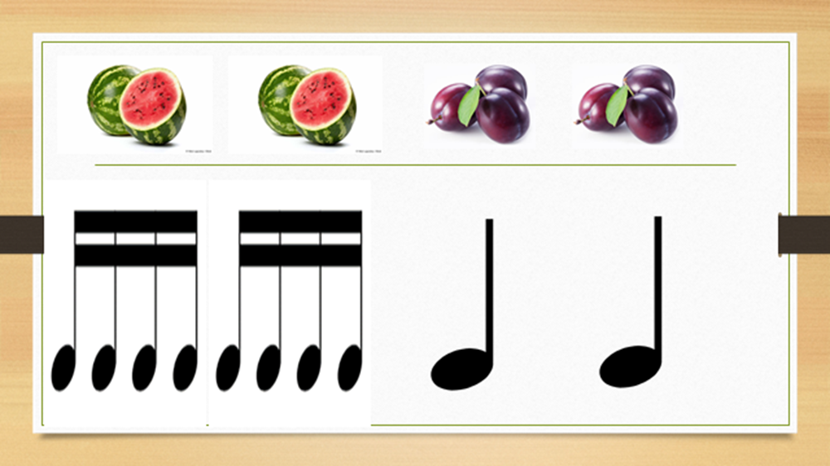
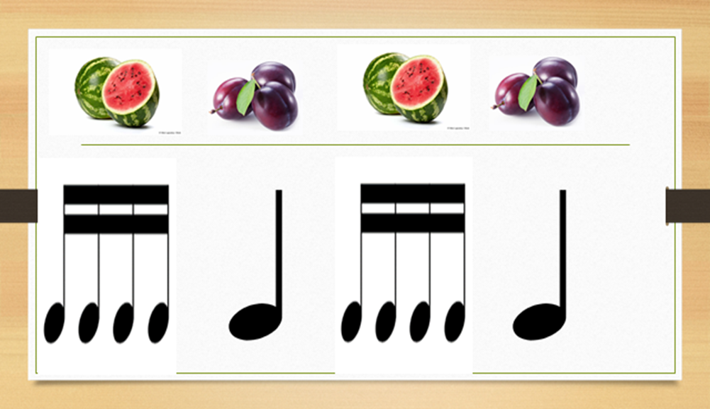
A | B
C | D

Slide 16

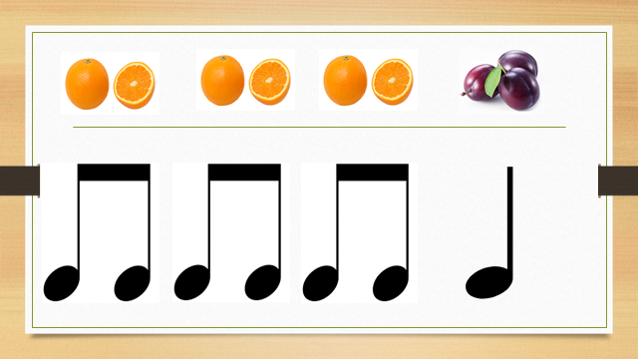
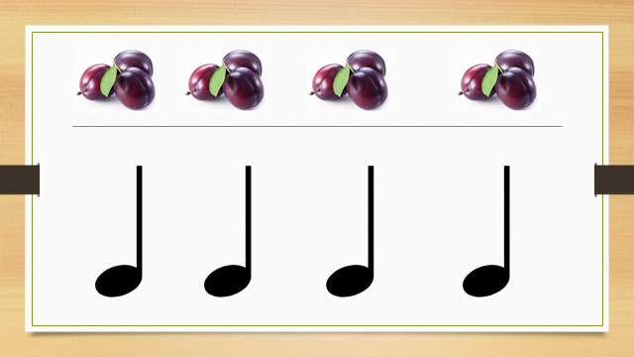
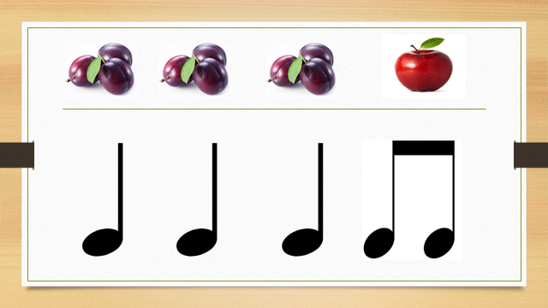
A | B
C | D

Slide 17
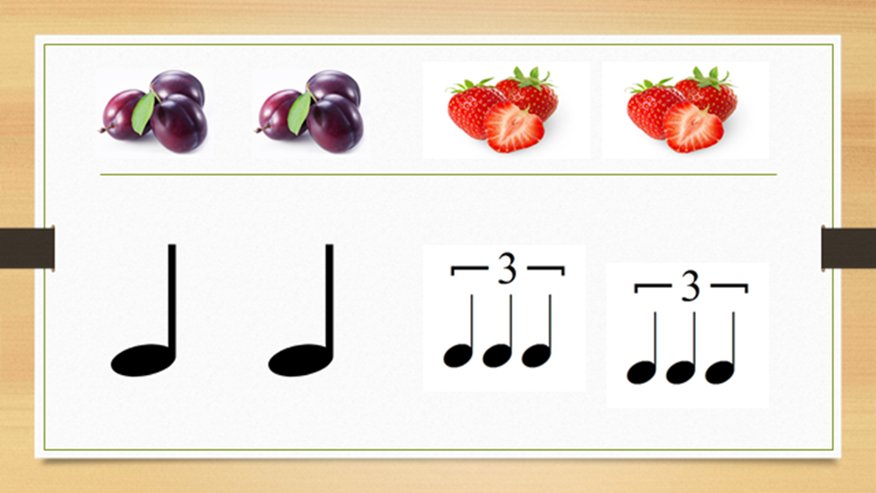
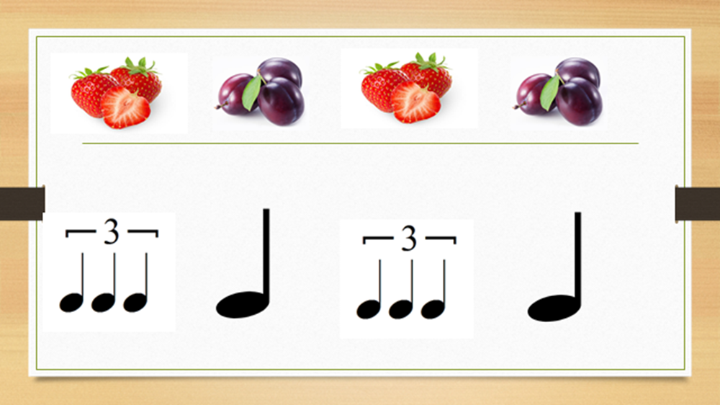

A | B
C | D

Slide 18
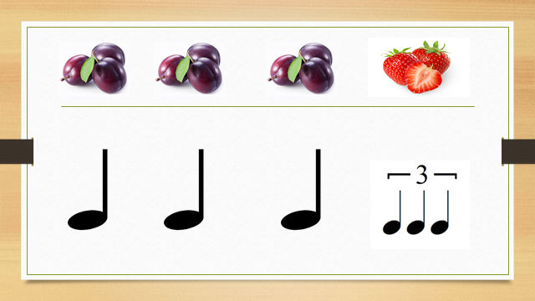
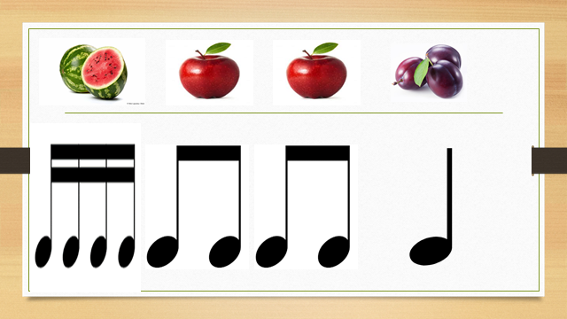
A | B
C | D

Slide 19
Listening Analyzing & Describing
GPS 6
Instrument Family Recognition

Slide 20
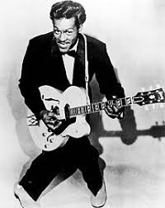
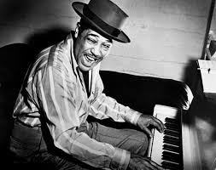
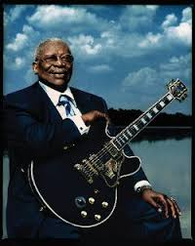
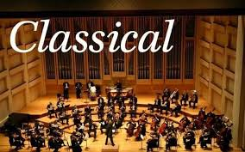
https://www.youtube.com/watch?v=DINAMy-_jSg
Rock and Roll
Jazz
Blues
Classical

Slide 21

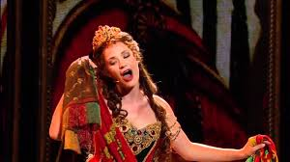
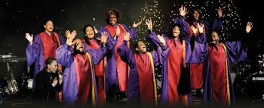
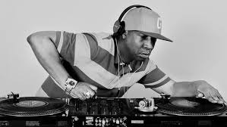
https://www.youtube.com/watch?v=YuBeBjqKSGQ
Opera
Country
Gospel
Hip-Hop

Slide 22
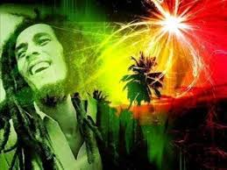


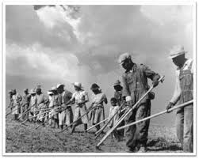
https://www.youtube.com/watch?v=pCFaTDBZQ9I
Latin
Reggae
Pop
Spiritual

Slide 23
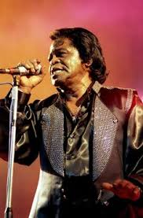

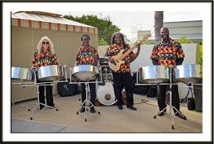
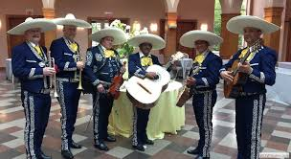
https://www.youtube.com/watch?v=GflOa05HmCY
Funk
American
Patriotic
Steel Drums
Mariachi

Slide 24
What Form do you Hear?
https://www.youtube.com/watch?v=qmSPdKoeEiw
Same
Different
AA
AB

Slide 25
What Form do you Hear?
https://www.youtube.com/watch?v=M7gxQpjezXA
Same
Different
ABA
AB

Slide 26
Evaluating Performances
GPS 7

Slide 27
What is wrong with this audiences behavior?
https://www.youtube.com/watch?v=TAaU8yPXA1A
Talking
Eating
cell phone ringing
Making Noise

Slide 28
What is right with this audiences behavior?
https://www.youtube.com/watch?v=KZUzC4eI
listening
No cell phones out
Not talking
Quiet

Slide 29
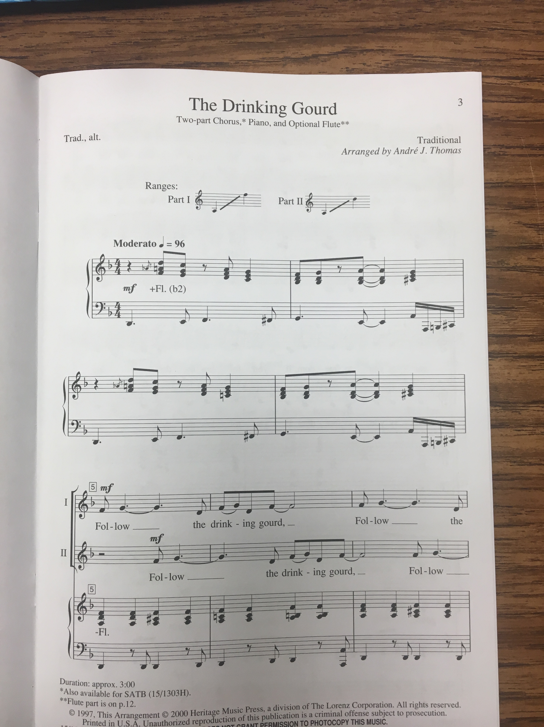
How many measures do you see?

Slide 30
How many measures do you see?
4
5
6
7

Slide 31
Enjoy Your SUMMER!

